Slide 1

Mobile Computing
Capstone Project
Moaath Alrajab

Slide 2
This presentation will cover:
What is the Capstone Project
Forming teams
Important dates
Ideas and proposal
Sensors
Proposal and initial design

Slide 3

Capstone Project?
The main objective of this course is to build creative, useful and interesting apps for Android devices.
The capstone project is an important assessment part of this course. It stands for 30% of the total grade.
You have to work in a team.

Slide 4

Forming Teams
To facilitate team creation, students should introduce themselves to the class in the first week.
By week 3, students should form groups of 3 or 4 members. In special cases, the instructor might allow 2.
Teamwork is essential in this course. Not being able to cooperate with others will result in a 10% reduction penalty per shortage.

Slide 5
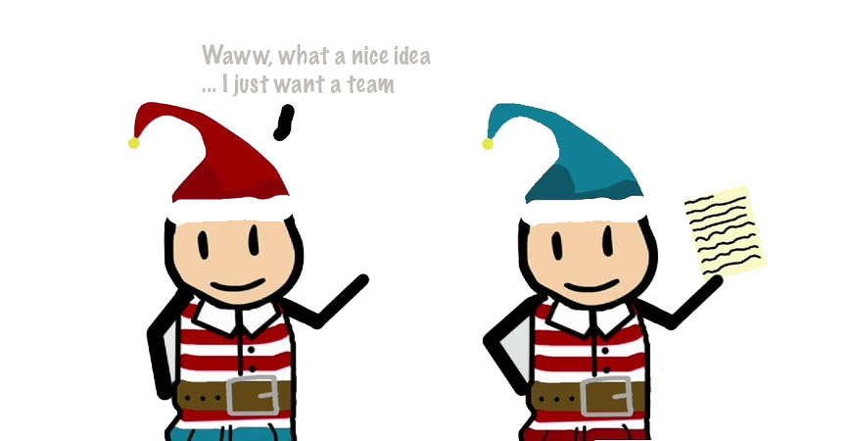
Forming Teams con’t
Start contacting your colleagues in week2. You may reply somebody’s post with a follow-up question, comment,… find a way to start a conversation.
Exchange ideas either on the discussion board or directly.
Share previous experience
By the end of Week3 we need to finalize team forming.
Still cannot think of any idea?
This presentation discusses some apps that use
Phone’ built-in sensors. Hopefully you do something
similar

Slide 6
Capstone Important millstones and dates
Assume the project is a 100%. The following is how the capstone project points is graded:
1. Forming Groups 5%
Week1: the introduction
Week2: brainstorming and initial group forming
Week3: groups to be created, named and announced.
2. Proposal/Approval of project 5%
Week4: students need to submit a draft of proposal for their project (max of 5 pages).
Week4: with 48 hours of submission, students will get feedbacks on their proposals.
Week5: proposals to be decided and announced.
3. Plan Document/Presentation 20%
Week6: Requirements, plan, schedule, sketches documents to be proposed:
https://marvelapp.com/
https://moqups.com/
Week7: Feedback, brainstorming and final modifications.
Week8: Plan to be finalized with ppt slides show.

Slide 7
Capstone Important milstones and dates
4. Interim Presentations 10%
Week9: Each group will be given
10 mins to present.
05 mins for discussions.
02 mins for none-presenting students to report their opinion.
5. Coding the project 50%
Weeks 9, 10, 11 and 12.
6. Final Presentation 10%
Weeks 13: similar to interim Presentation.
7. Final Submission
First day of week 15 @ 23:59pm EST: Submitting final report and code via canvas.

Slide 8
Ideas and proposal
Make sure to explore the links in the following slides.

Slide 9
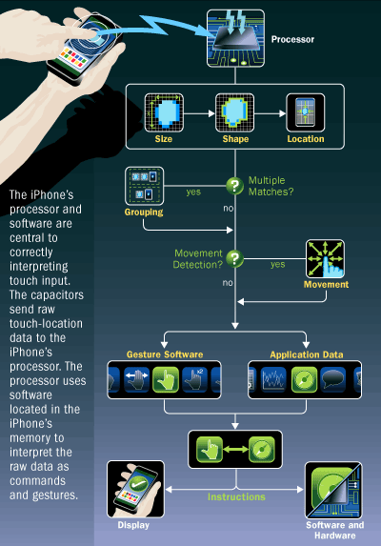
Input and sensors
The screen surface detects the touch
of a finger. Each touch can be
turned into a specific coordinate
Example:
pediped Sizing Guide
https://itunes.apple.com/app/id632252552

Slide 10
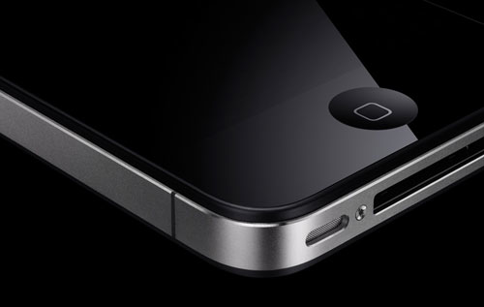
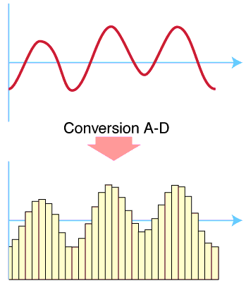
Microphone
Converts sound into data
– Microphone converts sound
waves into voltage
• Which varies over time
– Circuit converts voltage into
digital values
– Sound becomes a series of
digital values
• Get samples at 48K
samples/s
• Good quality sound
Examples:
Square https://squareup.com/reader
Breathometer https://www.youtube.com/watch?v=OpQsdjaLmto&ab_channel=CNET
Ocarina https://www.youtube.com/watch?v=wbg6GRRamNQ

Slide 11
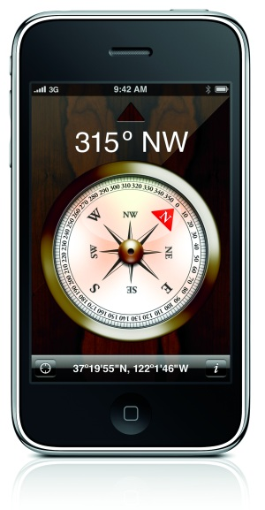
Compass
Really a magnetometer
– Can measure the magnetic field in 3
directions, X, Y, Z
– Magnetic flux measured in micro-Tesla
– Can use to make compass
– Could also use as an instrument to measure presence of magnetic fields
Where do magnetic fields exist?
– Speakers, motors, screens, medical
imaging, earth, big factories
Example: Cycloramic https://www.youtube.com/watch?v=tTMxyNyTsAY

Slide 12
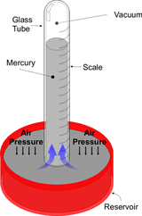
Barometer
Typical on Android & iPhone 6
– Not Ascend P6
– Measures atmospheric pressure
– Change and rate of change gives an
indication of weather
– Measurement in hPA – hectoPascals
– 1 atmosphere = 1013 hPA
Could use as altimeter

Slide 13
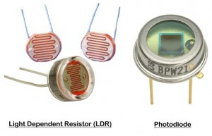
Ambient Light Sensor
Used for measuring ambient light to set screen brightness
Measures the light, in Lux
– Across wide range of values

Slide 14
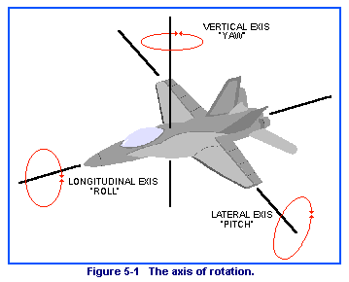
Gyroscope – measuring angular motion
Gives: pitch, roll, and yaw – of phone, along X,Y,Z axis
Gives a better sense of the
motion of the phone

Slide 15
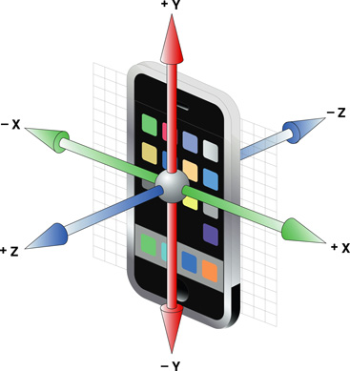
Accelerometer
Can measure acceleration in 3-dimensions as shown
Measured in m/s2 – Get measurement in each dimension X,Y,Z
Phone can give a ‘reading’ 100 times/s
Use for gestures

Slide 16
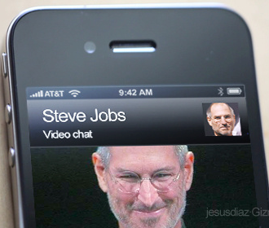
Camrea (front and back)
Allows for video interaction
– Skype uses this
– front camera is low resolution when compared to the back camera
Can look at you and see how
you’re feeling

Slide 17
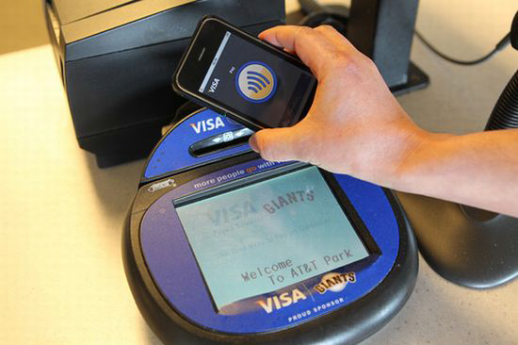
Near-Field Communications (NFC)
Another radio for very fast connection
for payments
recognition of ‘tag’
– When go home can walk past
desk, brings up calendar
– When dog goes by, gives
reminder of stuff to do with dog

Slide 18
Need help? Email me

